Slide 1




YumCart
Order Lifecycle Engine — Queue + Finite State Machine
Jenifer Vincy A
711524BEE027
Order
Delivery
Payment
Notify
github.com/jenifervincya/YumCart

Slide 2





THE PROBLEM
Every status change is a request, not a command
An order moves through a fixed set of stages, with side branches for cancellation and returns. Instead of updating status directly, every request is queued, validated against a rulebook, then applied or rejected — without ever stopping the system.
ORDER STATES
PLACED
CONFIRMED
SHIPPED
OUT_FOR_DELIVERY
Request
Queue
Validate
Apply
NOT_DELIVERED
DELIVERED
Invalid transitions are logged and skipped — one bad event never halts the pipeline.
CANCELLED
RETURNED
● terminal state
YumCart • Order Lifecycle LLD
2

Slide 3

DESIGN RATIONALE
Why Queue + State Machine?
Queue
State Machine
Decouples “a change was requested” from “the change was processed.” Guarantees requests are handled in order, one at a time.
Enforces that an order only moves to specific valid next-states from its current one. Arbitrary jumps, like Delivered → Placed, are rejected outright.
Together: a resilient pipeline where every state change is ordered, auditable, and provably valid.
YumCart • Order Lifecycle LLD
3

Slide 4



TRANSITION RULES
The order lifecycle, stage by stage
Placed
Confirmed
Shipped
Out for Delivery
Delivered
Not Delivered
retries → Out for Delivery
Cancelled
Returned
from Placed / Confirmed / Shipped / Not Delivered • terminal, no further transitions
from Delivered • terminal, no further transitions
YumCart • Order Lifecycle LLD
4

Slide 5
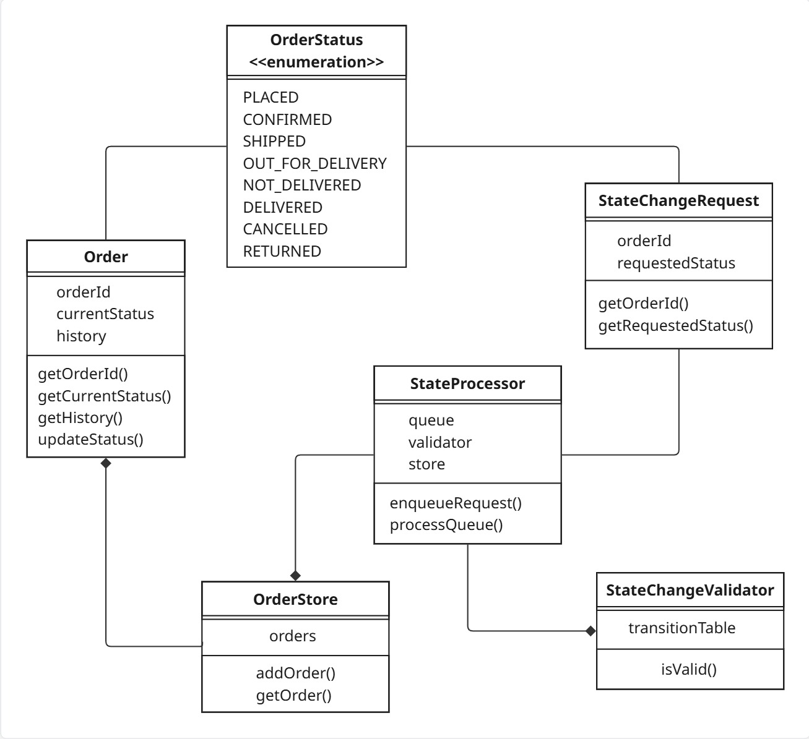
ARCHITECTURE
Core order module — class diagram
YumCart • Order Lifecycle LLD
5

Slide 6


ARCHITECTURE
Who does what
Order
OrderStatus
Holds an order's ID, current status, and status history
The fixed enum of valid order states
StateChangeRequest
StateChangeValidator
A queued request: which order, which new status
Holds the transition rulebook; checks if a move is legal
OrderStore
StateProcessor
Stores and retrieves Order objects by ID
Drains the queue, validates, and applies or rejects each request
YumCart • Order Lifecycle LLD
6

Slide 7
ARCHITECTURE
How the pieces connect
FROM
TO
TYPE
RELATIONSHIP
StateProcessor
StateChangeValidator
Composition
validates via
StateProcessor
OrderStore
Composition
stores via
StateProcessor
StateChangeRequest
Association
consumes
OrderStore
Order
Composition
holds
Order
OrderStatus
Association
has current status
StateChangeRequest
OrderStatus
Association
requests
YumCart • Order Lifecycle LLD
7

Slide 8



ROADMAP
Modules being layered on top
Each new module follows the same queue / validator / store pattern where it fits.
User
Restaurant & Menu
Cart
Delivery Assignment
Customer, RestaurantOwner, DeliveryPartner
Profiles, menu items, availability
Single-restaurant cart, quantities, subtotal
Queue-based nearest-partner matching
Payment
Notification
Pricing
Its own FSM: Pending → Success/Failed → Refunded
Observer pattern hooked into status changes
Strategy pattern for discounts, tax, delivery fee
YumCart • Order Lifecycle LLD
8

Slide 9

FRONTEND
Two roles, two very different views
Standalone HTML/CSS/JS demo, deployed live via GitHub Pages, sharing mock order data.
Seller / Admin
Customer
Search any order
Read-only view
Push it to its next status
Search an order and see current status
Watch the manifest log update live as the queue processes it
Delivery timeline visible — no controls to change status
Intentionally separated: a customer should never have access to status-change controls.
YumCart • Order Lifecycle LLD
9

Slide 10

DESIGN NOTES
Principles behind the choices
Fault-tolerant queue
Full audit trail
Rejected transitions don't stop the queue — the system logs and continues, since one bad event shouldn't halt the whole pipeline.
History is tracked per order so the complete lifecycle can be reviewed end to end.
Single responsibility
Role separation
OrderStore and StateProcessor are kept separate — storage and queue-processing concerns evolve independently.
Seller and customer roles are intentionally split in the frontend for safety and clarity.
YumCart • Order Lifecycle LLD
10

Slide 11


See it in action
Try the seller and customer views yourself
Live Demo
jenifervincya.github.io/YumCart
Source Code
github.com/jenifervincya/YumCart
Next up: Delivery Assignment, Payment FSM, and Notification observer wiring.

